Slide 1
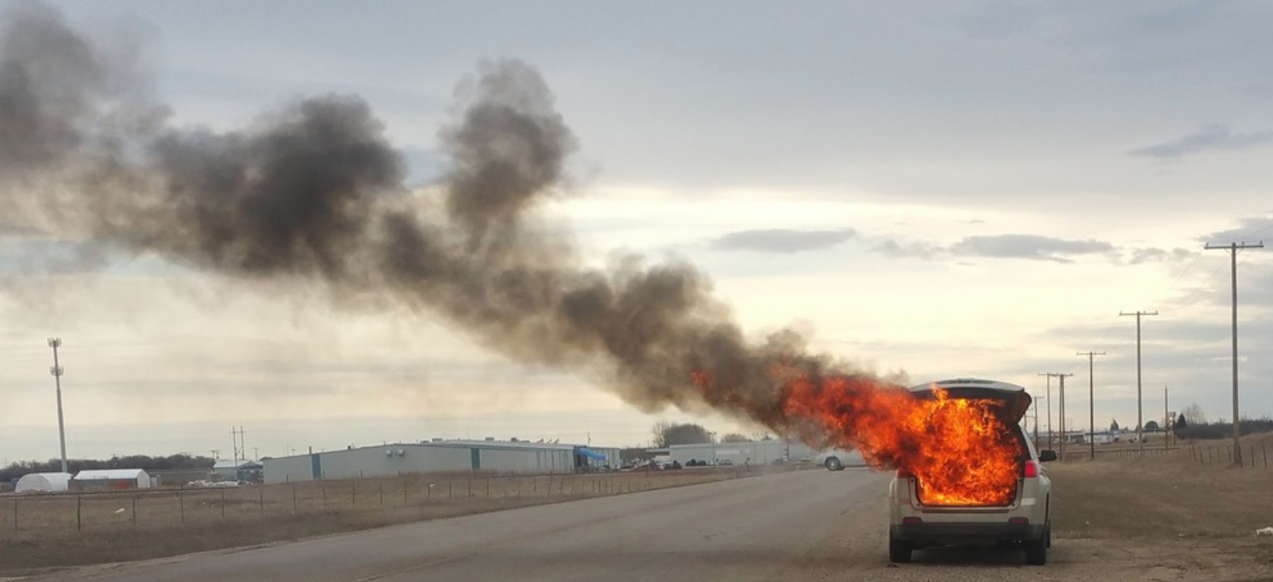
Collision Severity Prediction in Seattle City
Applied Data Science Capstone Project
Yuying Ren
09/09/2020

Slide 2
Introduction: Collision Severity Prediction in the Era of Big Data
Traffic accidents are the 8th cause of mortality in different countries and are expected to rise to the 3rd rank by 2020
Collision severity prediction has attracted more and more attention as more data becomes available
By understanding when, where, how and why severe collisions happen, cities across the globe could not only stop millions of disabilities and deaths, but also avoid or at least ease the cities’ finance and improve public health
First responders can use the prediction to improve their effectiveness
Individual travelers can use the prediction to assess their traveling needs
This project aims to predict whether a collision in Seattle city will cause personal injury or not

Slide 3
Data Acquisition and Cleaning
All collisions data provided by SDOT
Includes all types of collisions and associated information, as such weather condition, road condition, and light condition
From 2004 to Present
In total, 194,673 rows and 38 features in the dataset
Data format is harmonized
Features that are not appropriate to predict collision severity are dropped
Categorical features are converted into values
Missing values are assessed and removed
The clean dataset contains 187,223 records and six features

Slide 4
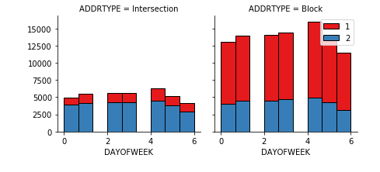
Feature Selection: Using Plots to Understand Data
For example, by looking at the histogram of collision severity code shows that during weekend, more collisions were identified as type 1 collision----the collisions with property damage only

Slide 5
Predictive Modeling: Classification
To predict collision severity, a predictive model is used
Both regression and classification can be used in a predictive model
Since the target variable is binary, classification model is selected
This project applied 4 classification machine learning algorithms:
K Nearest Neighbor (KNN)
Decision Tree
Support Vector Machine (SVM)
Logistic Regression

Slide 6
Performance Evaluation: Jaccard Index, F1 Score, and Log Loss
Since the dataset is imbalanced, F1 score may be more informative than Accuracy
The high Log Loss represents a high entropy, and indicates that the Logistic Regression model is not a good fit
Algorithms | Jaccard Index | F1 Score | Log Loss
KNN | 0.6522 | 0.6226 | N/A
Decision Tree | 0.6967 | 0.5791 | N/A
SVM | 0.6967 | 0.5791 | N/A
Logistic Regression | 0.6964 | 0.5821 | 0.9610

Slide 7
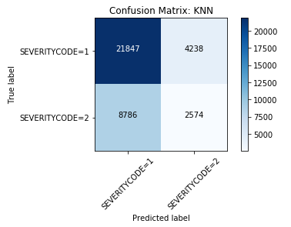
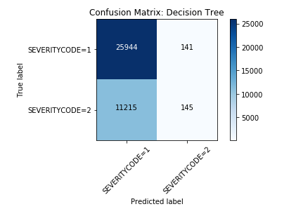
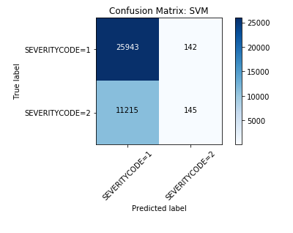
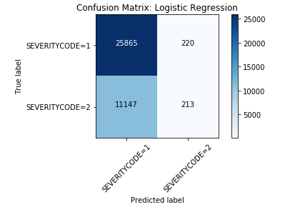
Performance Evaluation: Confusion Matrix
In this particular problem, lower false negative count is more important as travelers’ and first responders’ behaviors might be impacted

Slide 8
Conclusion & Future Directions
Built predictive models using machine learning algorithms
Results can be applied to predicting collision severity and identifying the key effects of contributed factors
Accuracy of the models has room for improvement
Some factors, which have potential effects on collision severity, are not considered because of the large amount of missing data
E.g. driver characteristics, whether speeding was observed
Further study should be conducted to examine the impacts of these factors

Slide 9
Thank You
Thanks to everyone who made the IBM Data Science Professional Certificate available, especially everyone on the Instructors team who helped me get here.
Big thank you to all my peers who kindly reviewed my assignments. Without you, I could not be able to do any of this.

